Slide 1
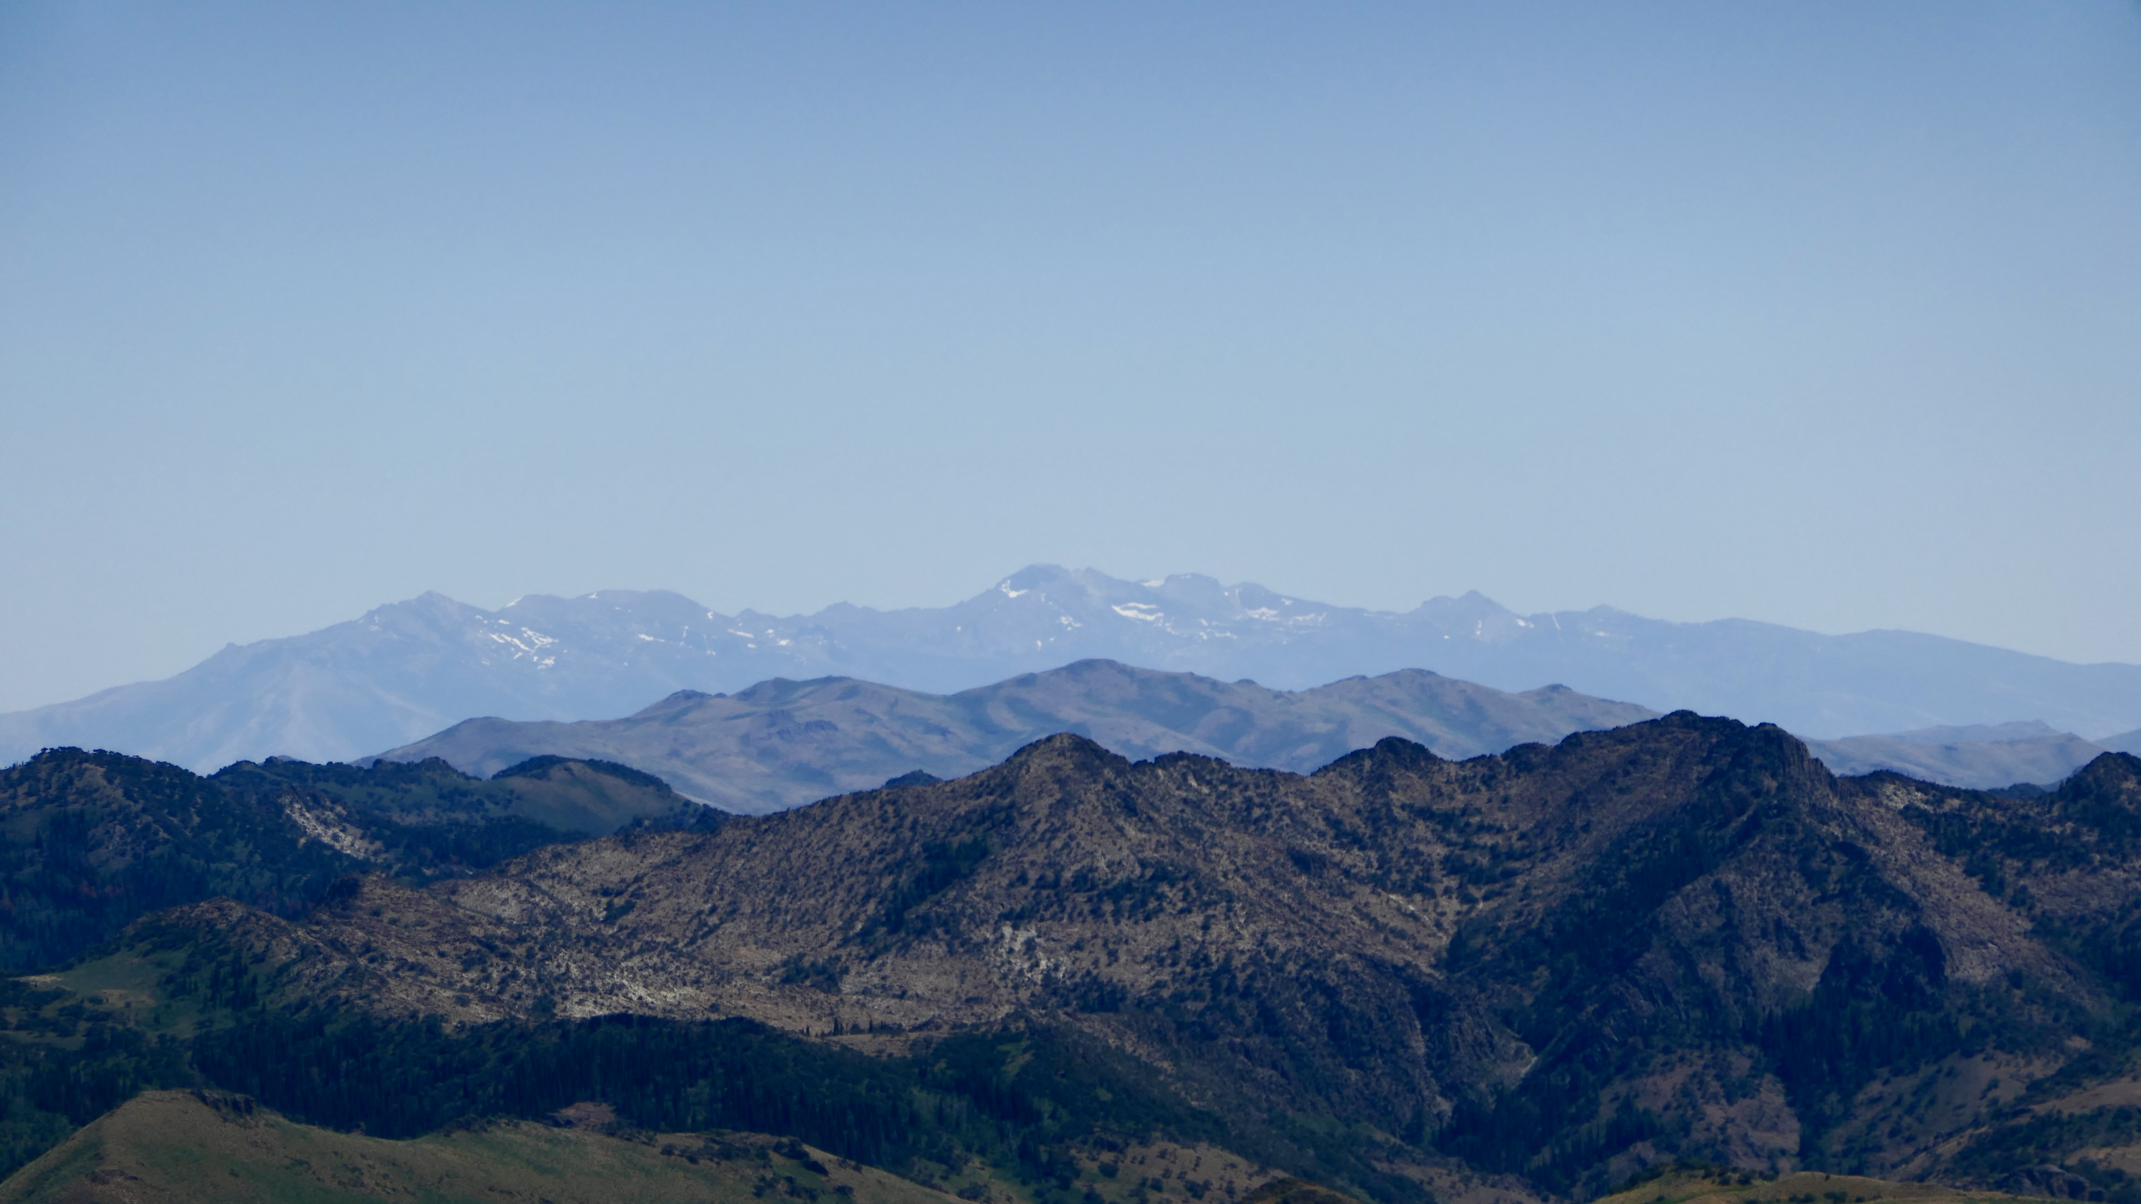
Tectonic & Magmatic Development of The Great Basin During Late Cenozoic Time
Paper by McKee & Noble, 1986
Presentation by Solomon Feinstein

Slide 2
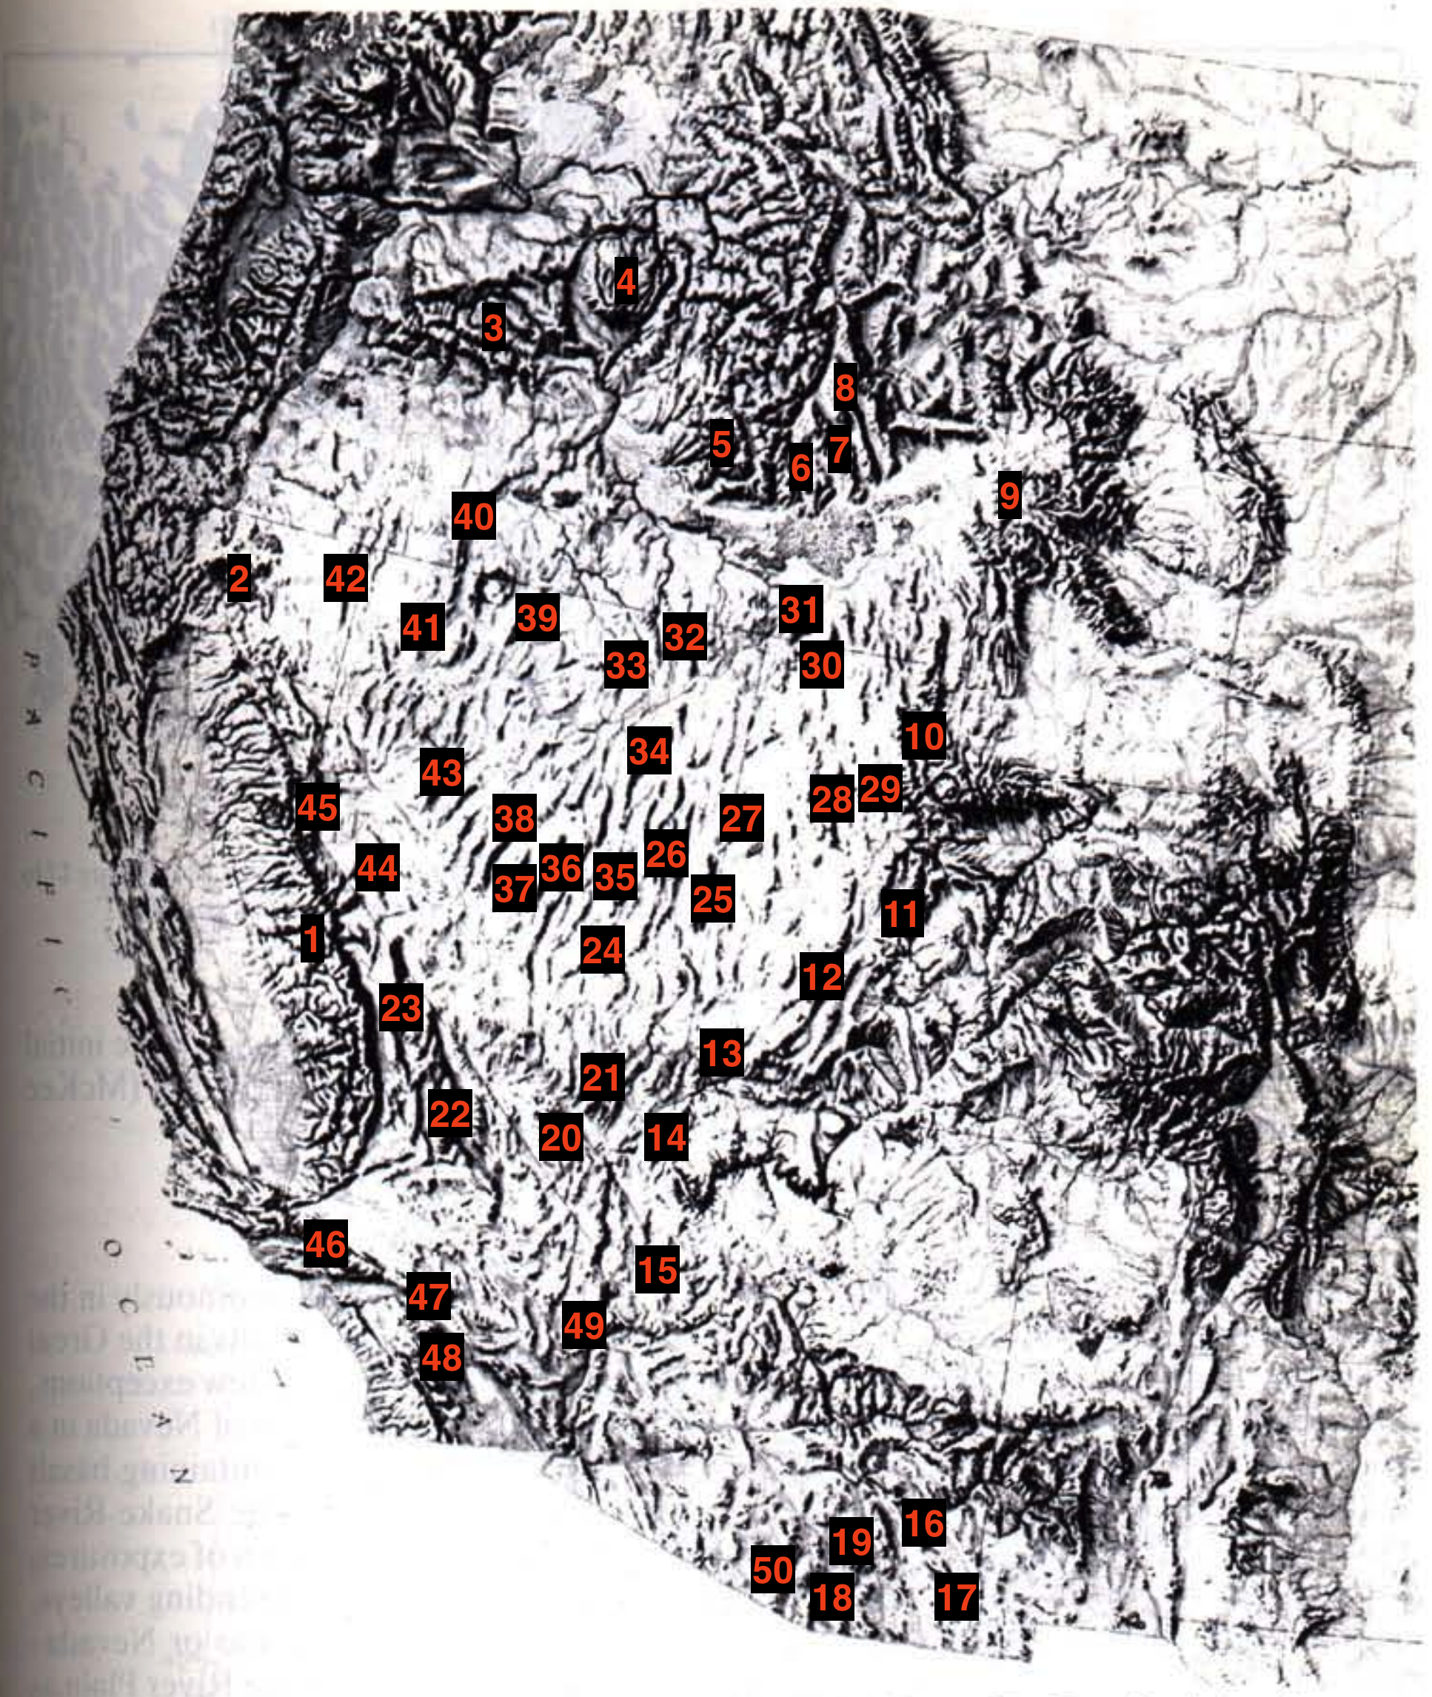
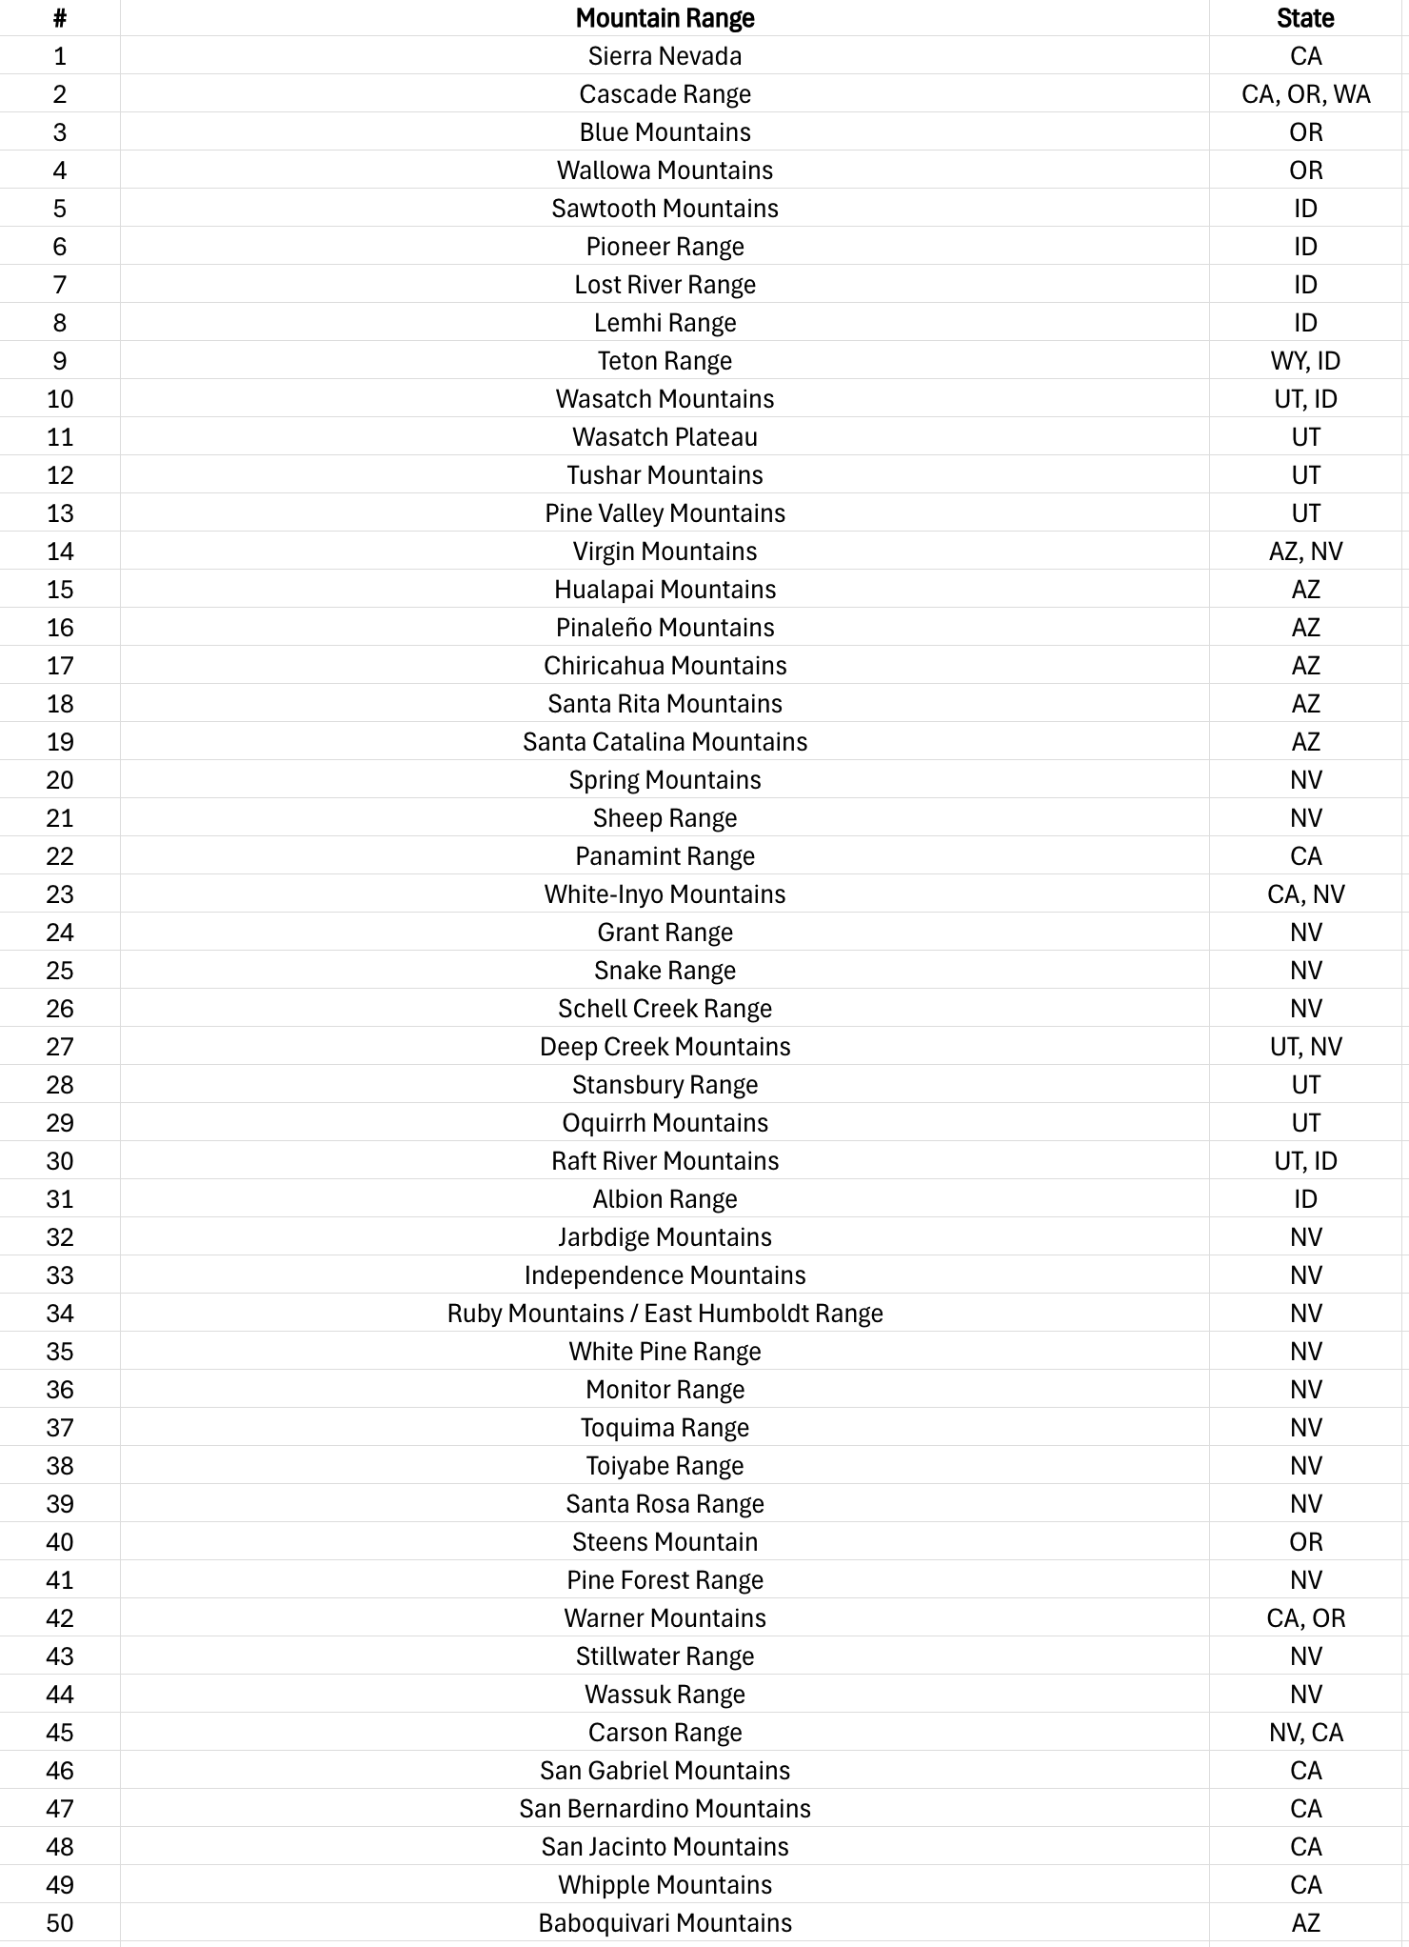

Slide 3
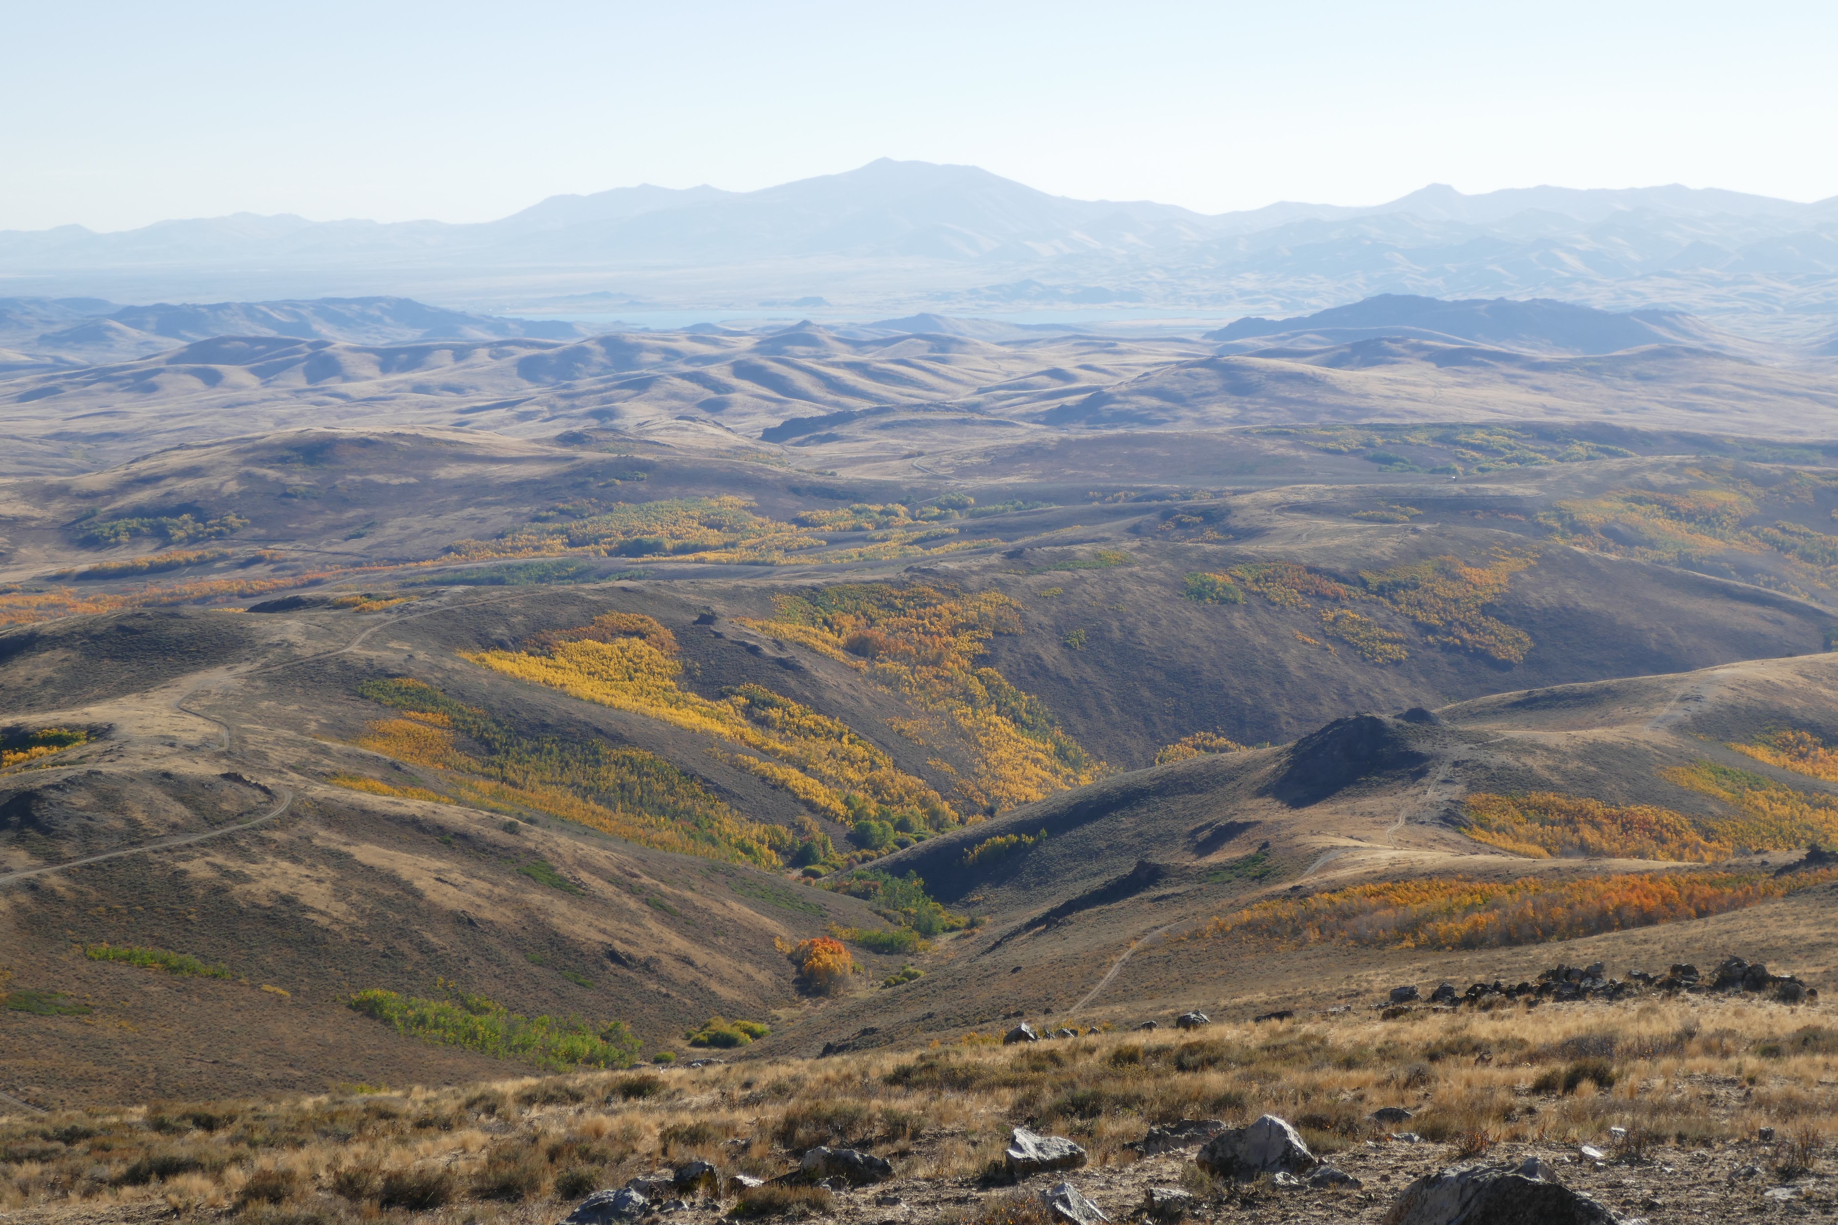
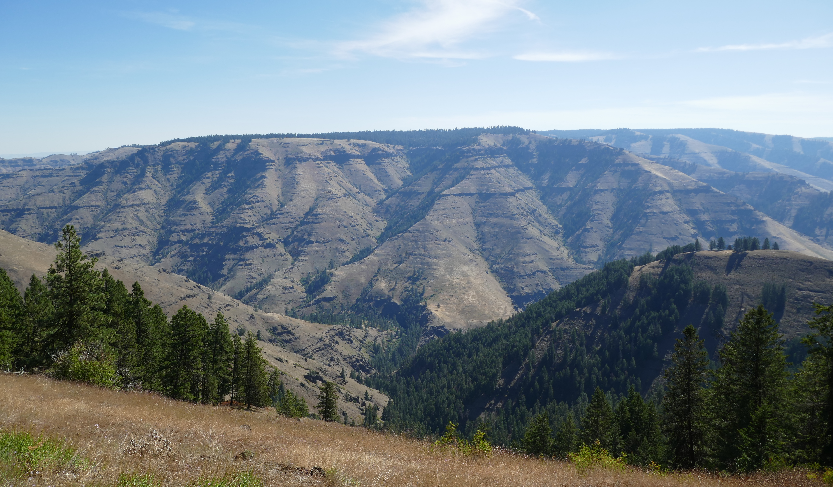
Introduction
Tectonic Development of Western US is a 2-chapter story
Subduction of Farallon Plate (40-18 MA Igneous Rocks, Chapter 1)
Crustal Extension (<18 MA igneous basalts & rhyolites of Great Basin & Columbia Plateau, Normal Faults, Chapter 2)
Chapter 2 is the topic of this paper

Slide 4
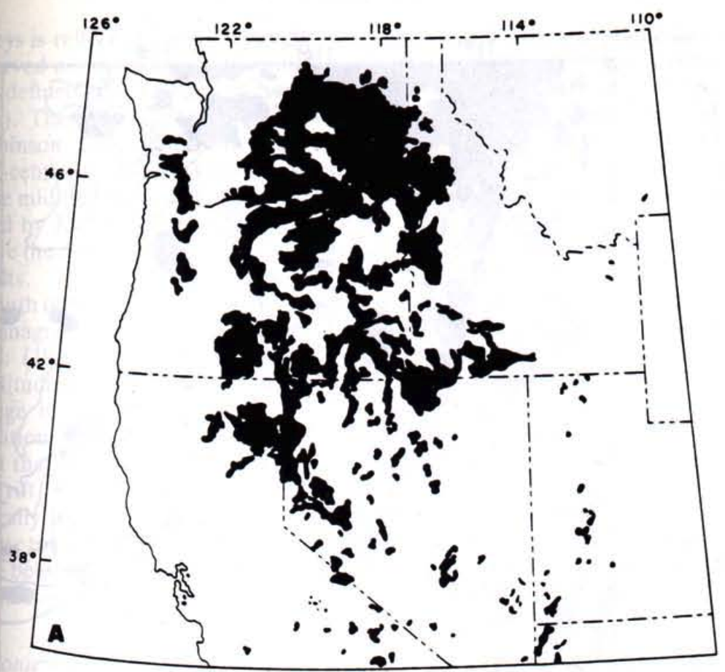
Inter-regional Comparison: GB & CP
The Great Basin and Columbia Plateau may be more similar than you might think…
There are significant similarities and features in both regions that point to a shared late Cenozoic magmatic & tectonic history
Basalts of Middle Miocene age and younger overlap the GB/CP boundary and seem to relate from a common source & tectonic system
North-trending dike swarms of the same origin are found both in the Great Basin and Columbia Plateau
Although both provinces share some features, differences between the two suggest that both GB & CP were reacting differently to the same tectonic system

Slide 5
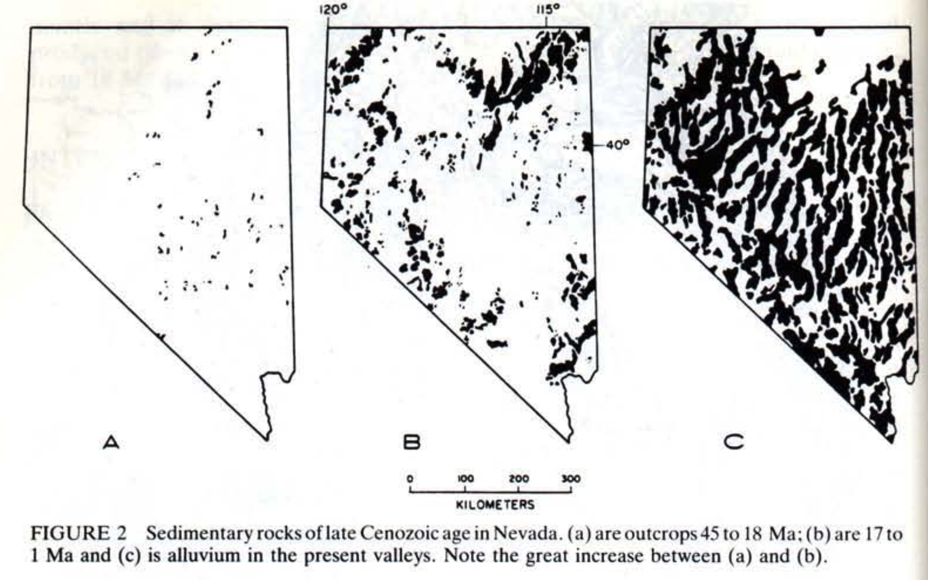
Late Cenozoic Sedimentary Rocks

Slide 6
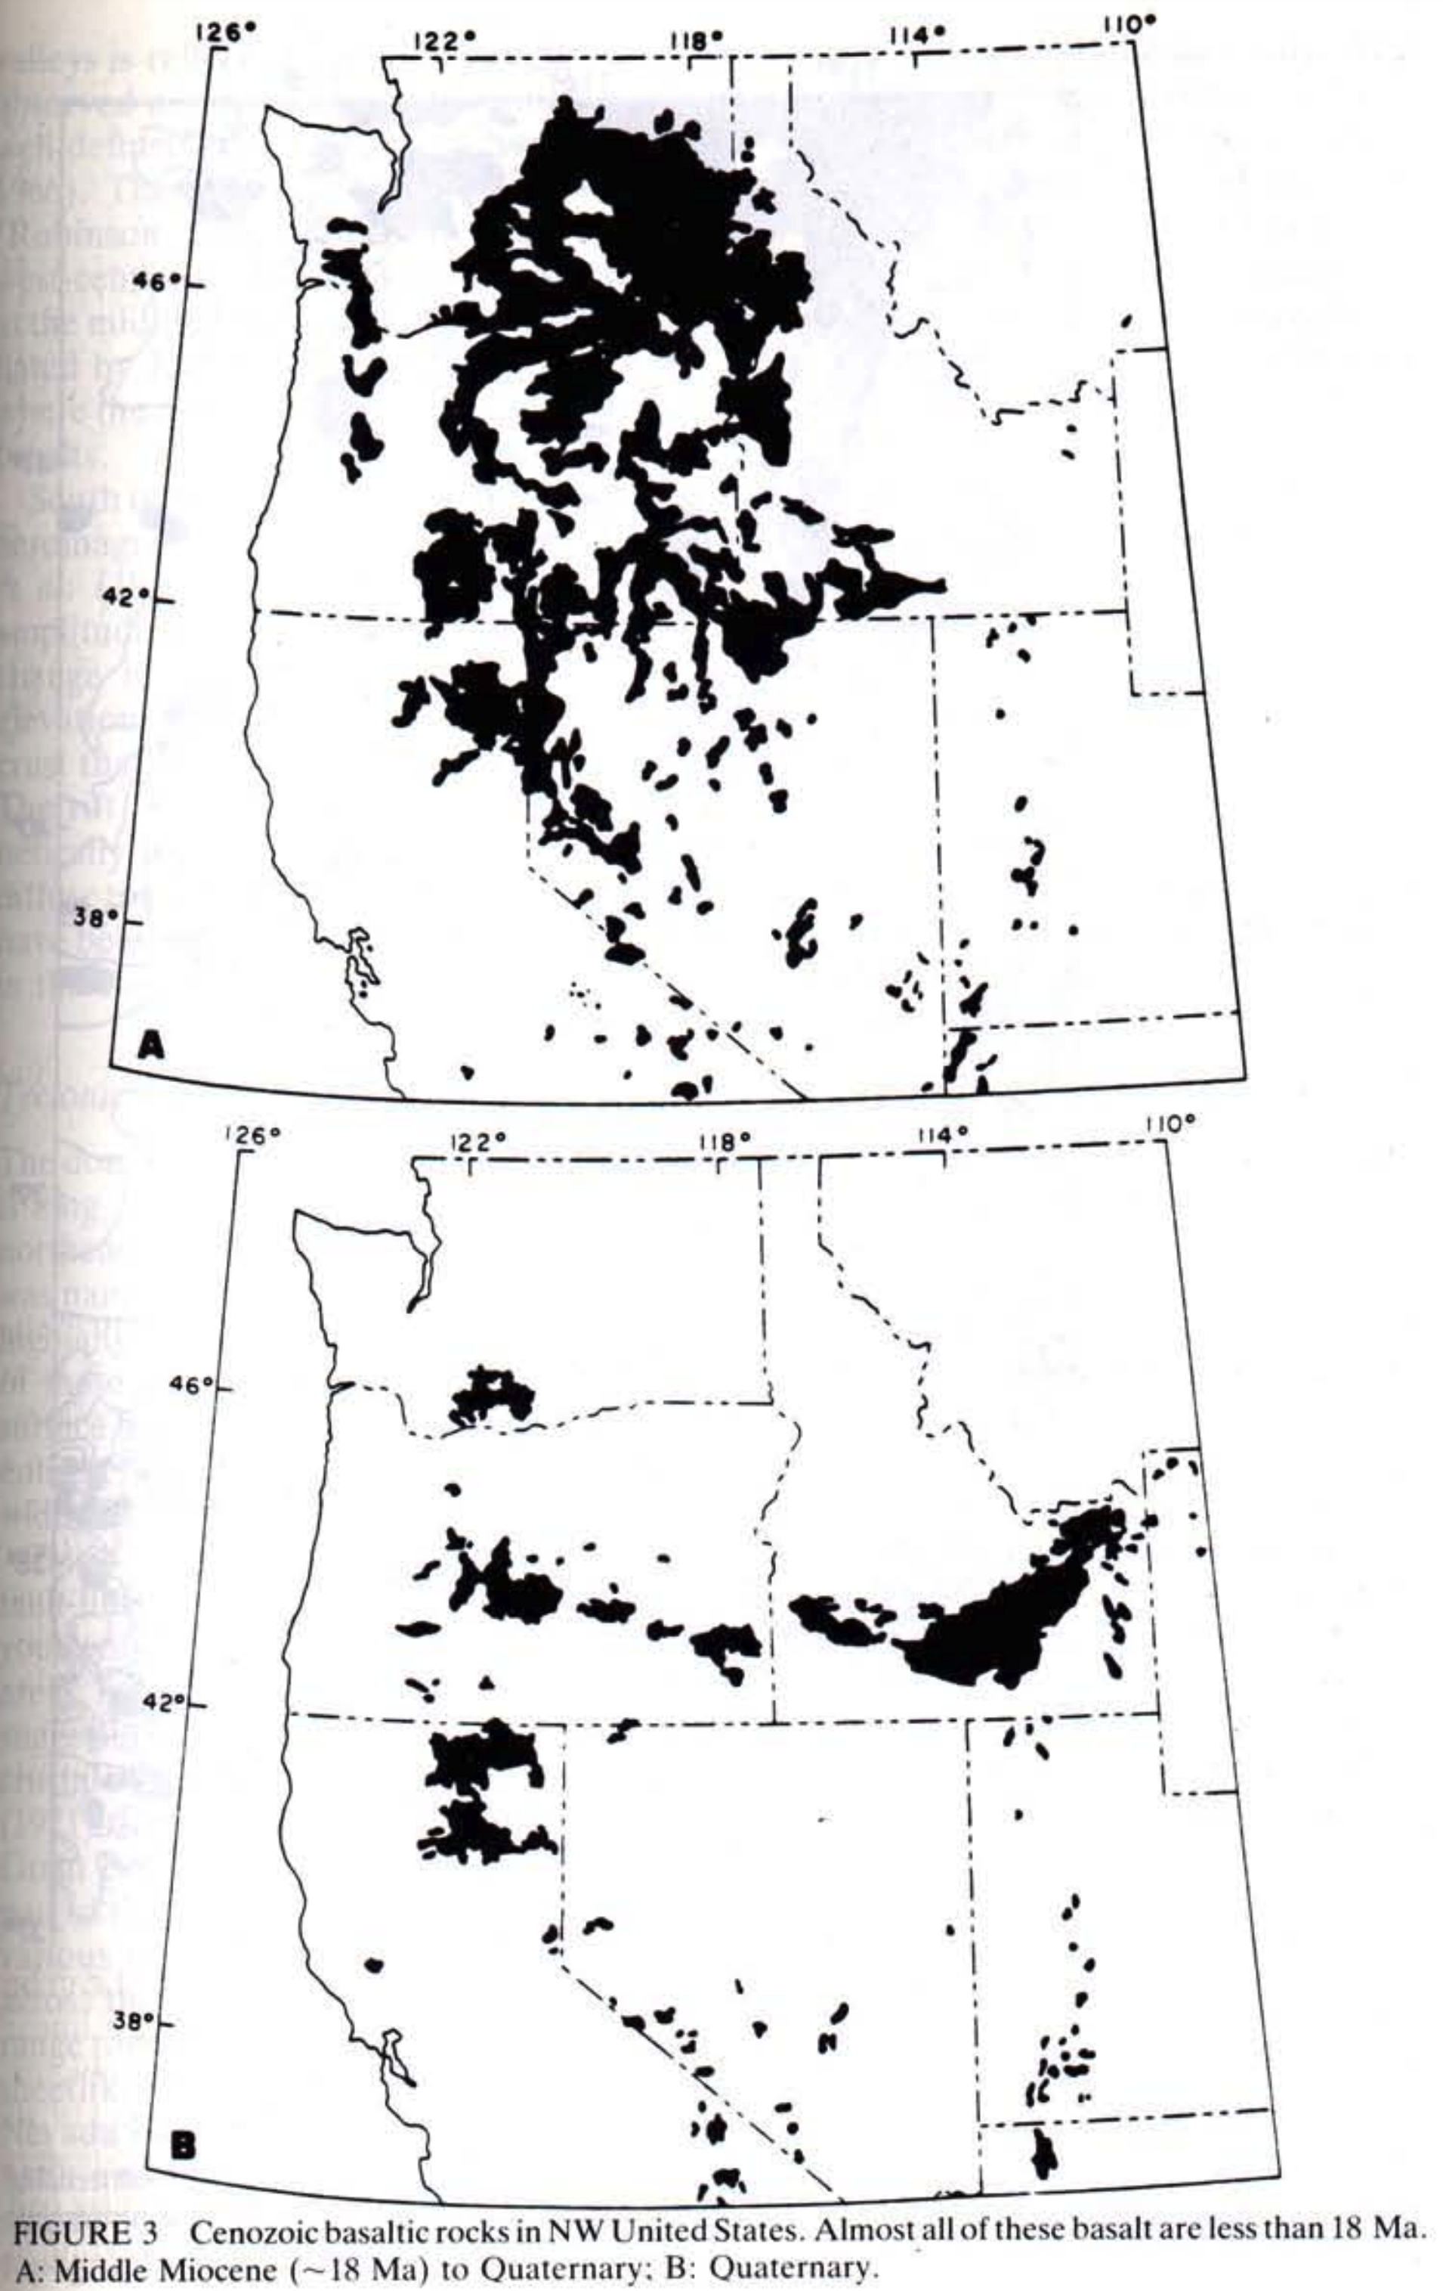
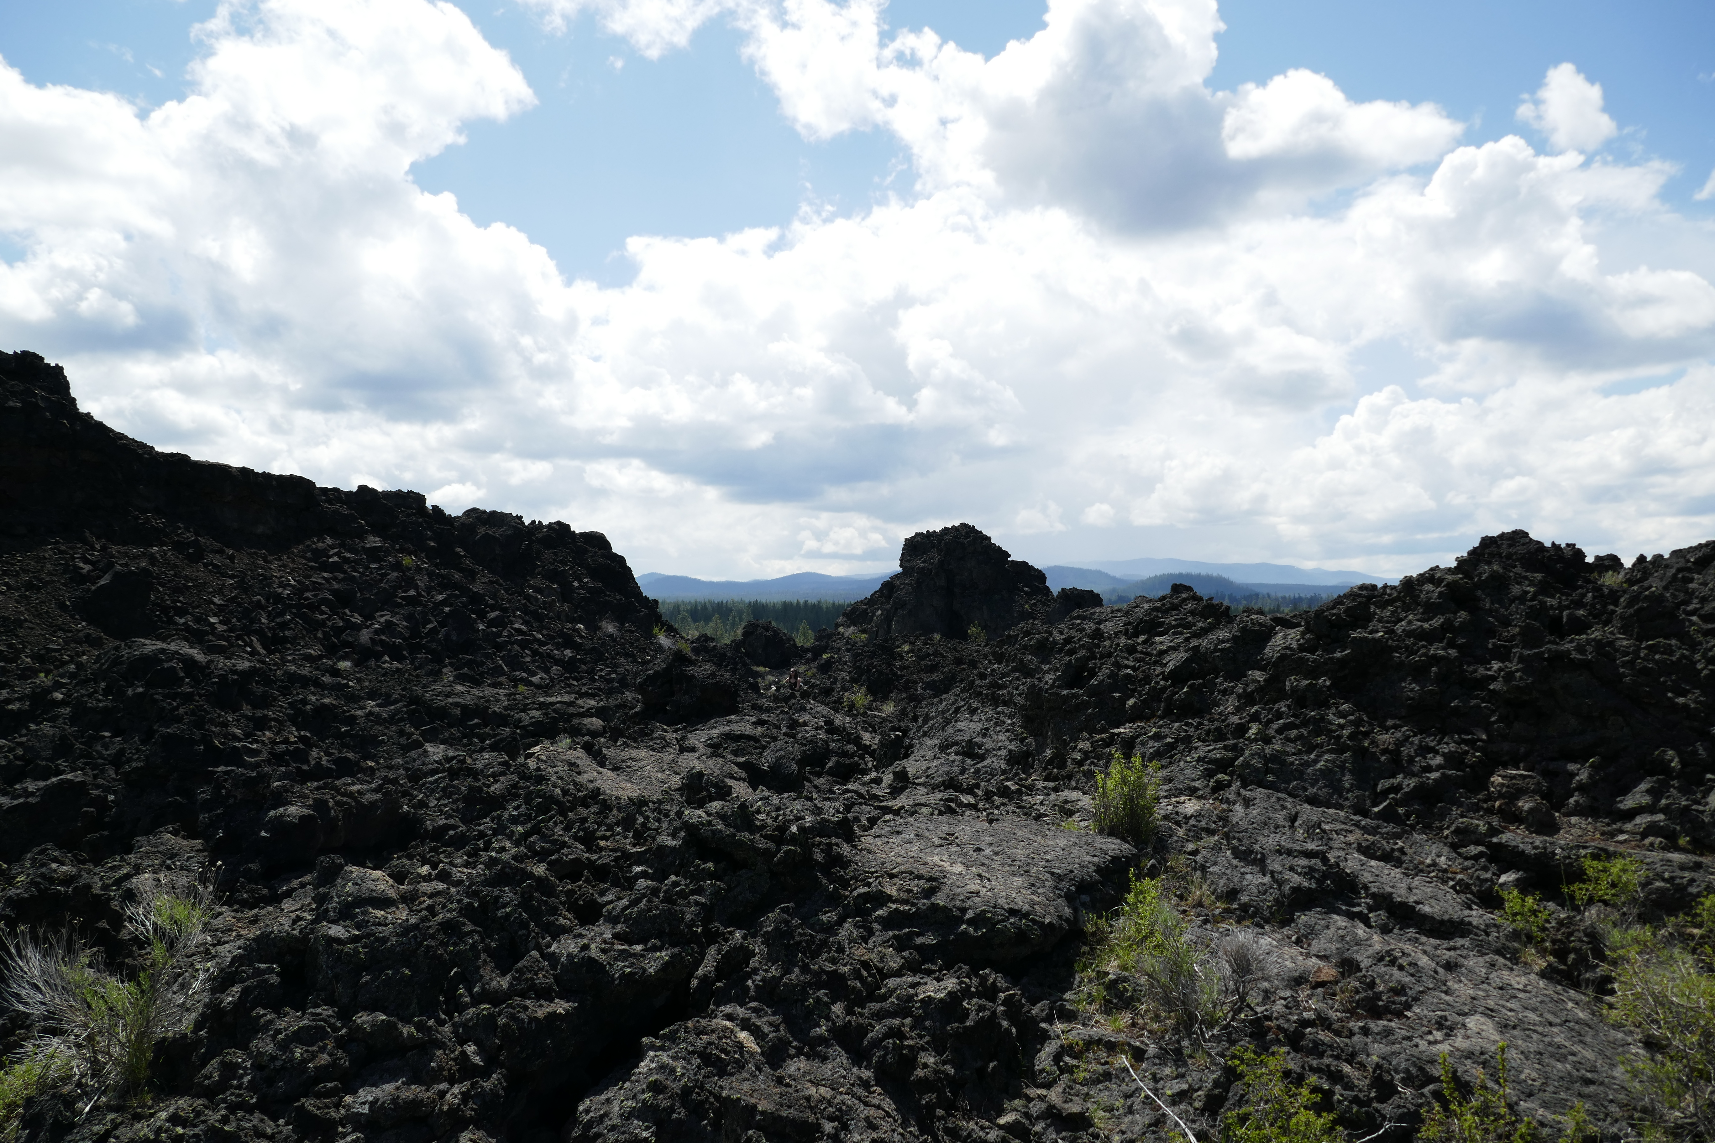
Miocene-Present Basaltic Rocks

Slide 7
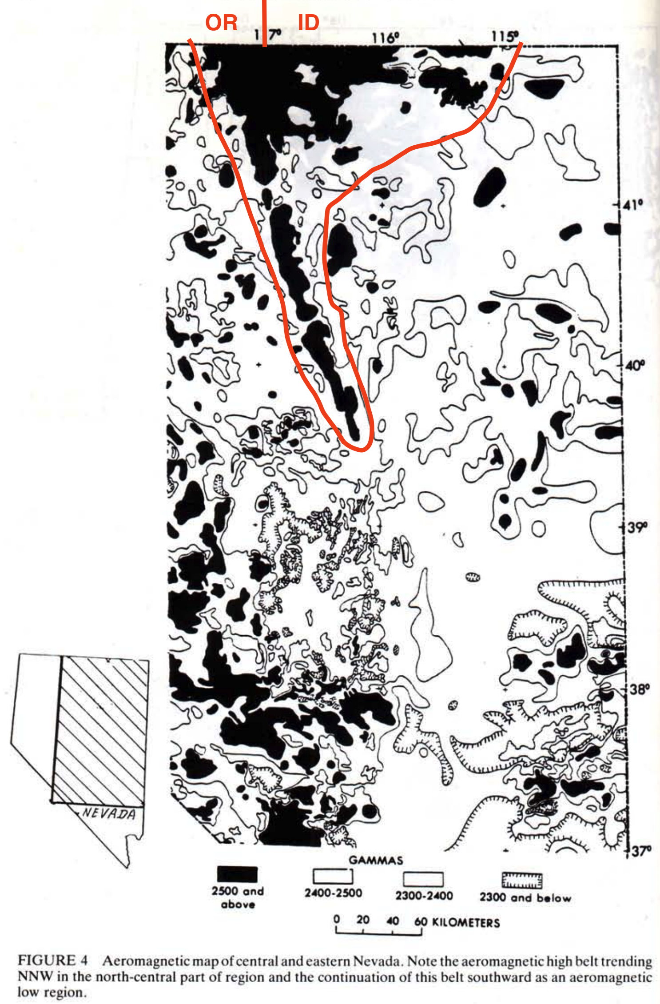
Northern Nevada Rift (Aeromagnetic Features)
Linear high zone of aero-magnetism trending N/NW from Eureka, NV, to northern Nevada State Line, called the “Oregon-Nevada Lineament” in this paper
“A deep, well-defined zone of basaltic rock superimposed on near-surface rocks”
200 km long
10 km wide
10-15 km deep
“in a general way, a line of symmetry in the middle of the (Great Basin) province”
Becomes wider towards Snake River Plain, may have marked the beginning of extension in the area

Slide 8
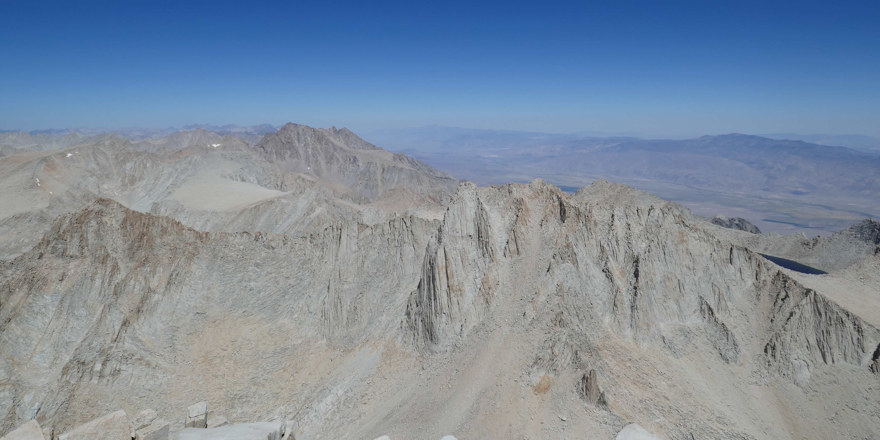
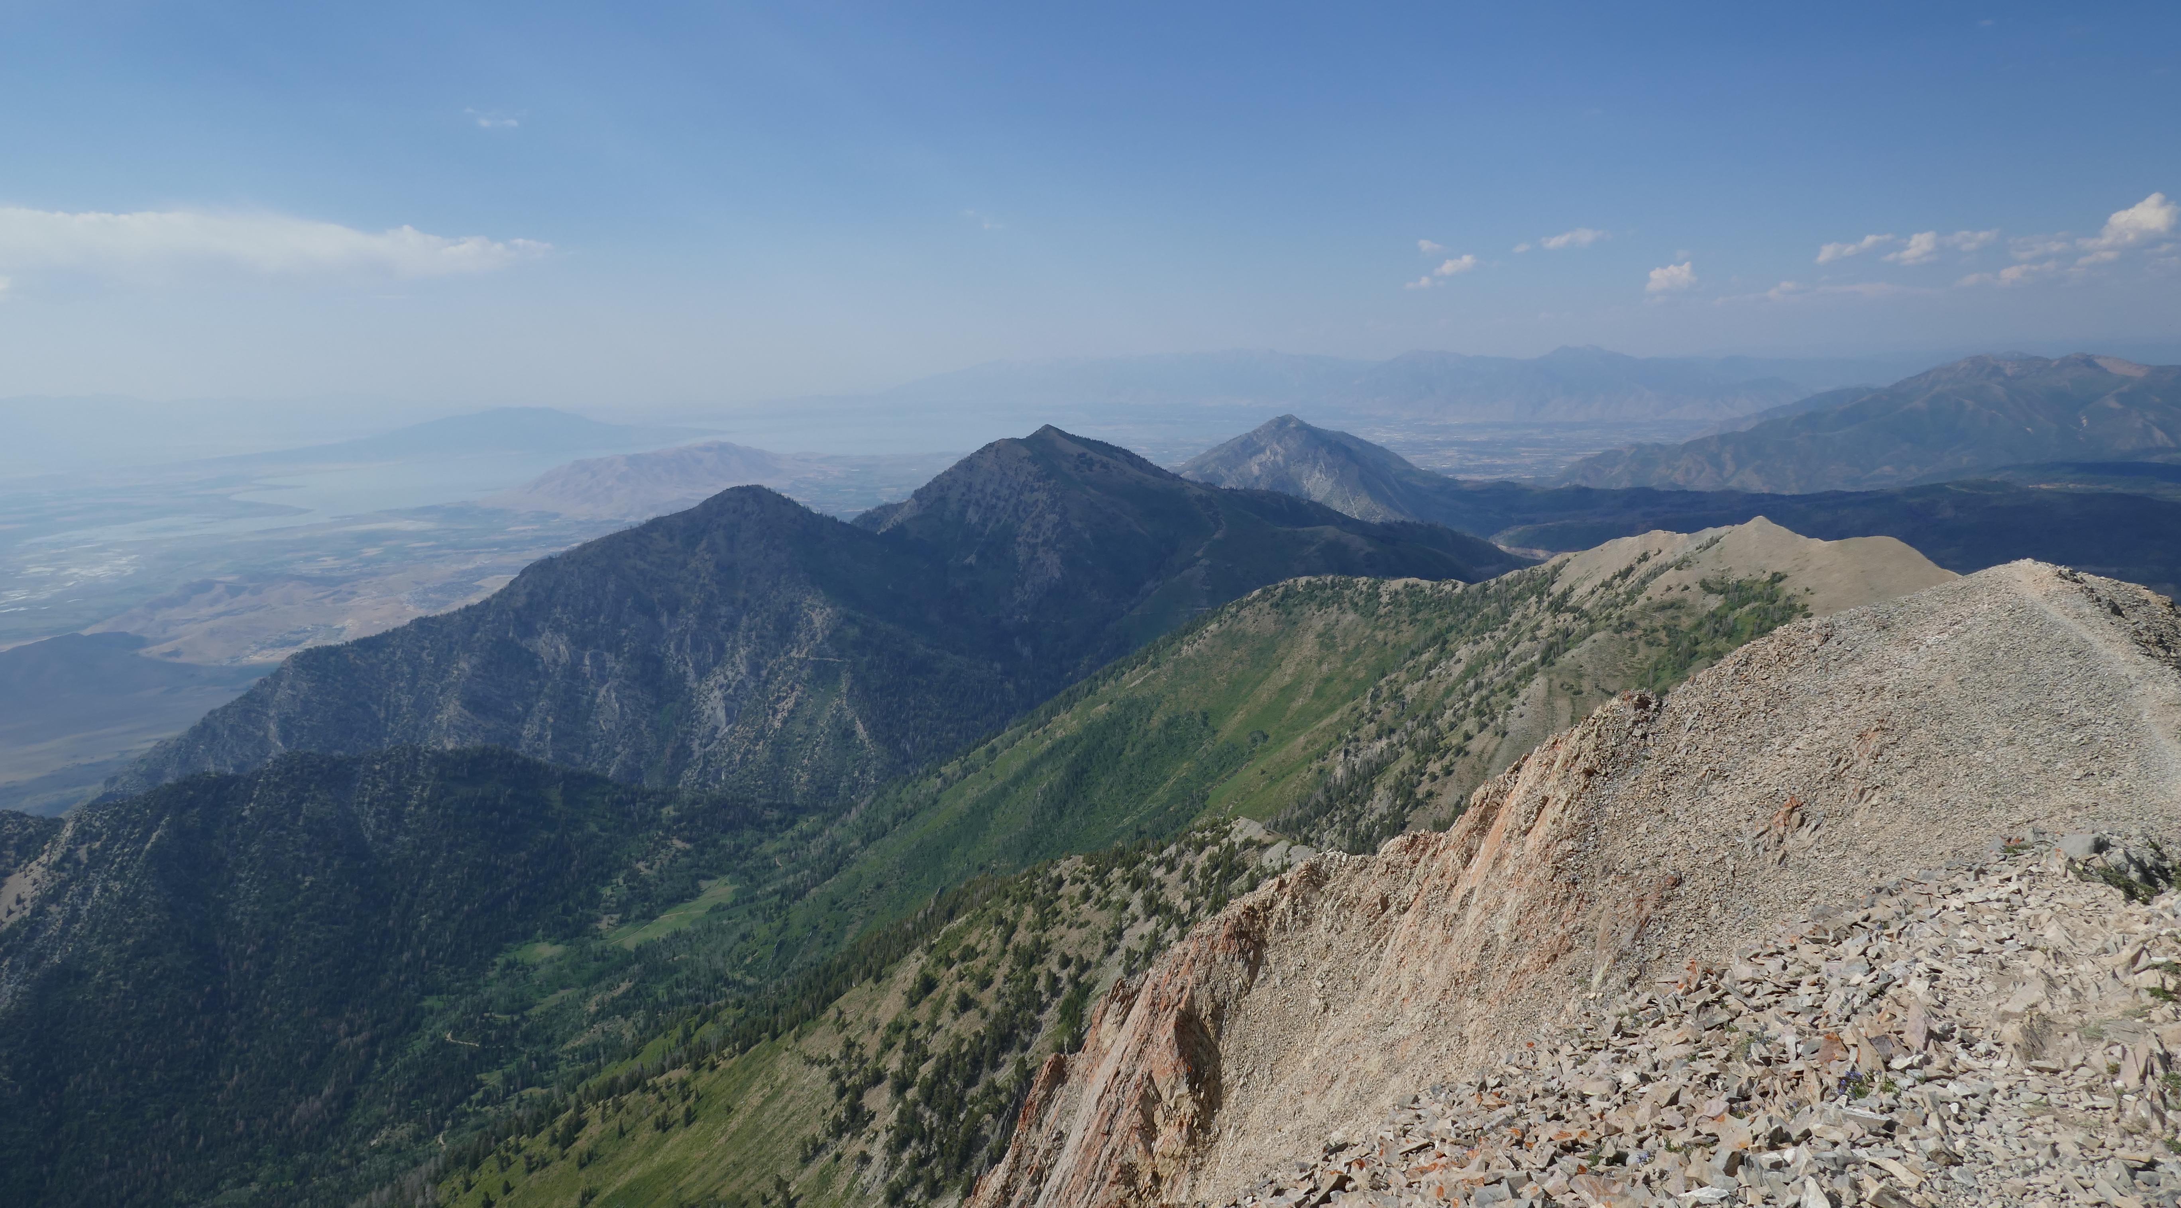
Tectonic Features
Range-bounding normal faults, long, narrow basins & ranges, trending N-NE
Faulting still active across Great Basin, but most active along eastern & western margins
These regions are likely the loci of most active crustal extension
Extension likely started in the middle (18 Ma) & migrated to the edges
Abundant evidence that B/R topography did not exist here prior to 18 Ma, as sheet-like ash flows from 25-20 Ma across central Nevada suggest limited vertical topography, as well as 18 Ma onset of Late Cenozoic sediments/alluvial fans (none before that)

Slide 9
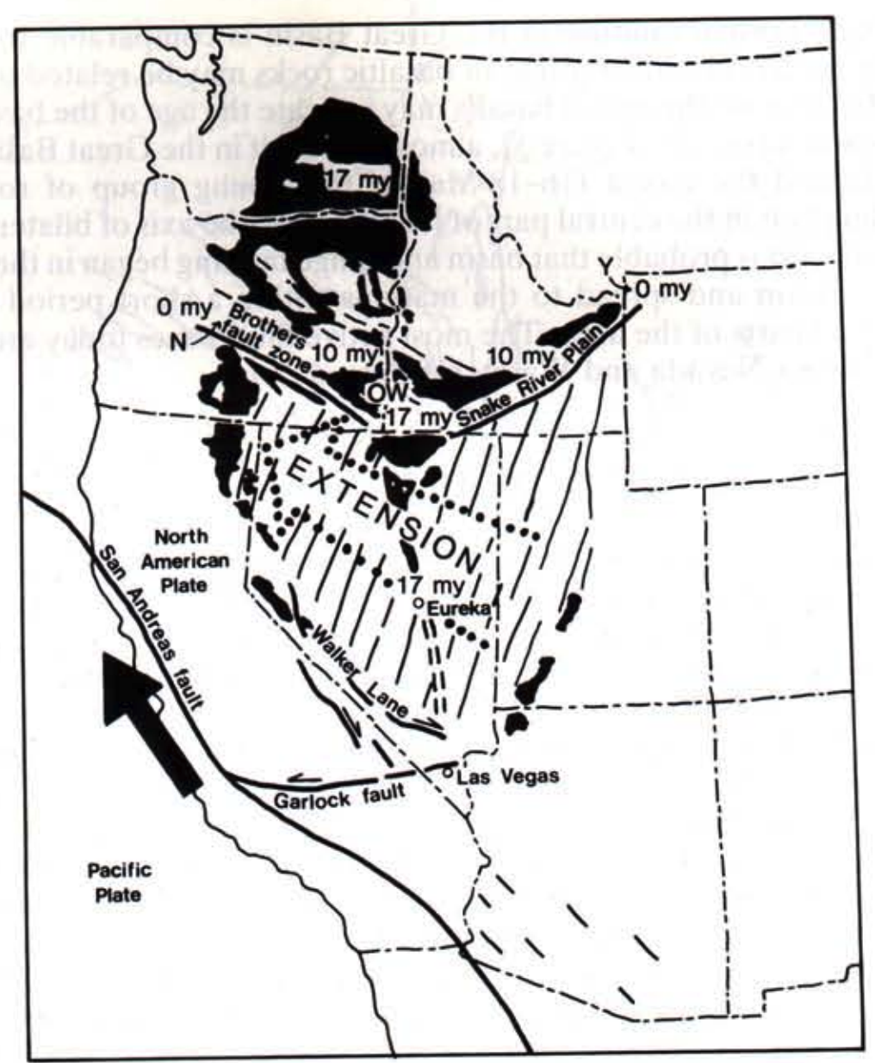
Conclusions, Part 1
After 18 Ma, basalt became the widespread volcanic rock type, especially in the northern Great Basin & Columbia Plateau
At the same time, normal faulting and E-W extension commenced, beginning in 18 Ma in Central Nevada and propagating east towards the Wasatch and west towards the Sierras
This region of extension is bounded by east-trending structures at about 37ºN, hence geologic history south of there is different
The northern boundary of the Great Basin is a strike-slip fault known as the Brothers Fault Zone
This paper ascertains that drag by the northerly moving Pacific block along the San Andreas fault caused Great Basin Crustal Extension and the Columbia River Flood Basalts, and that south of the Brothers Fault, extension is still active, but north of it, its dead
What do you think?

Slide 10
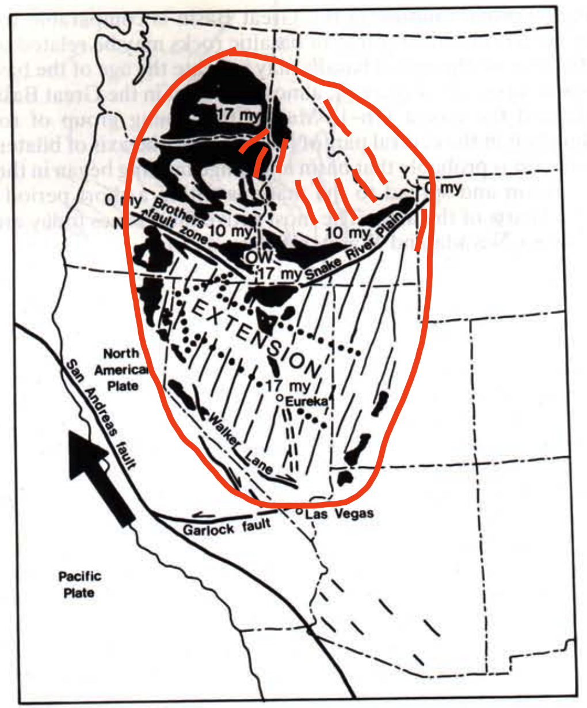
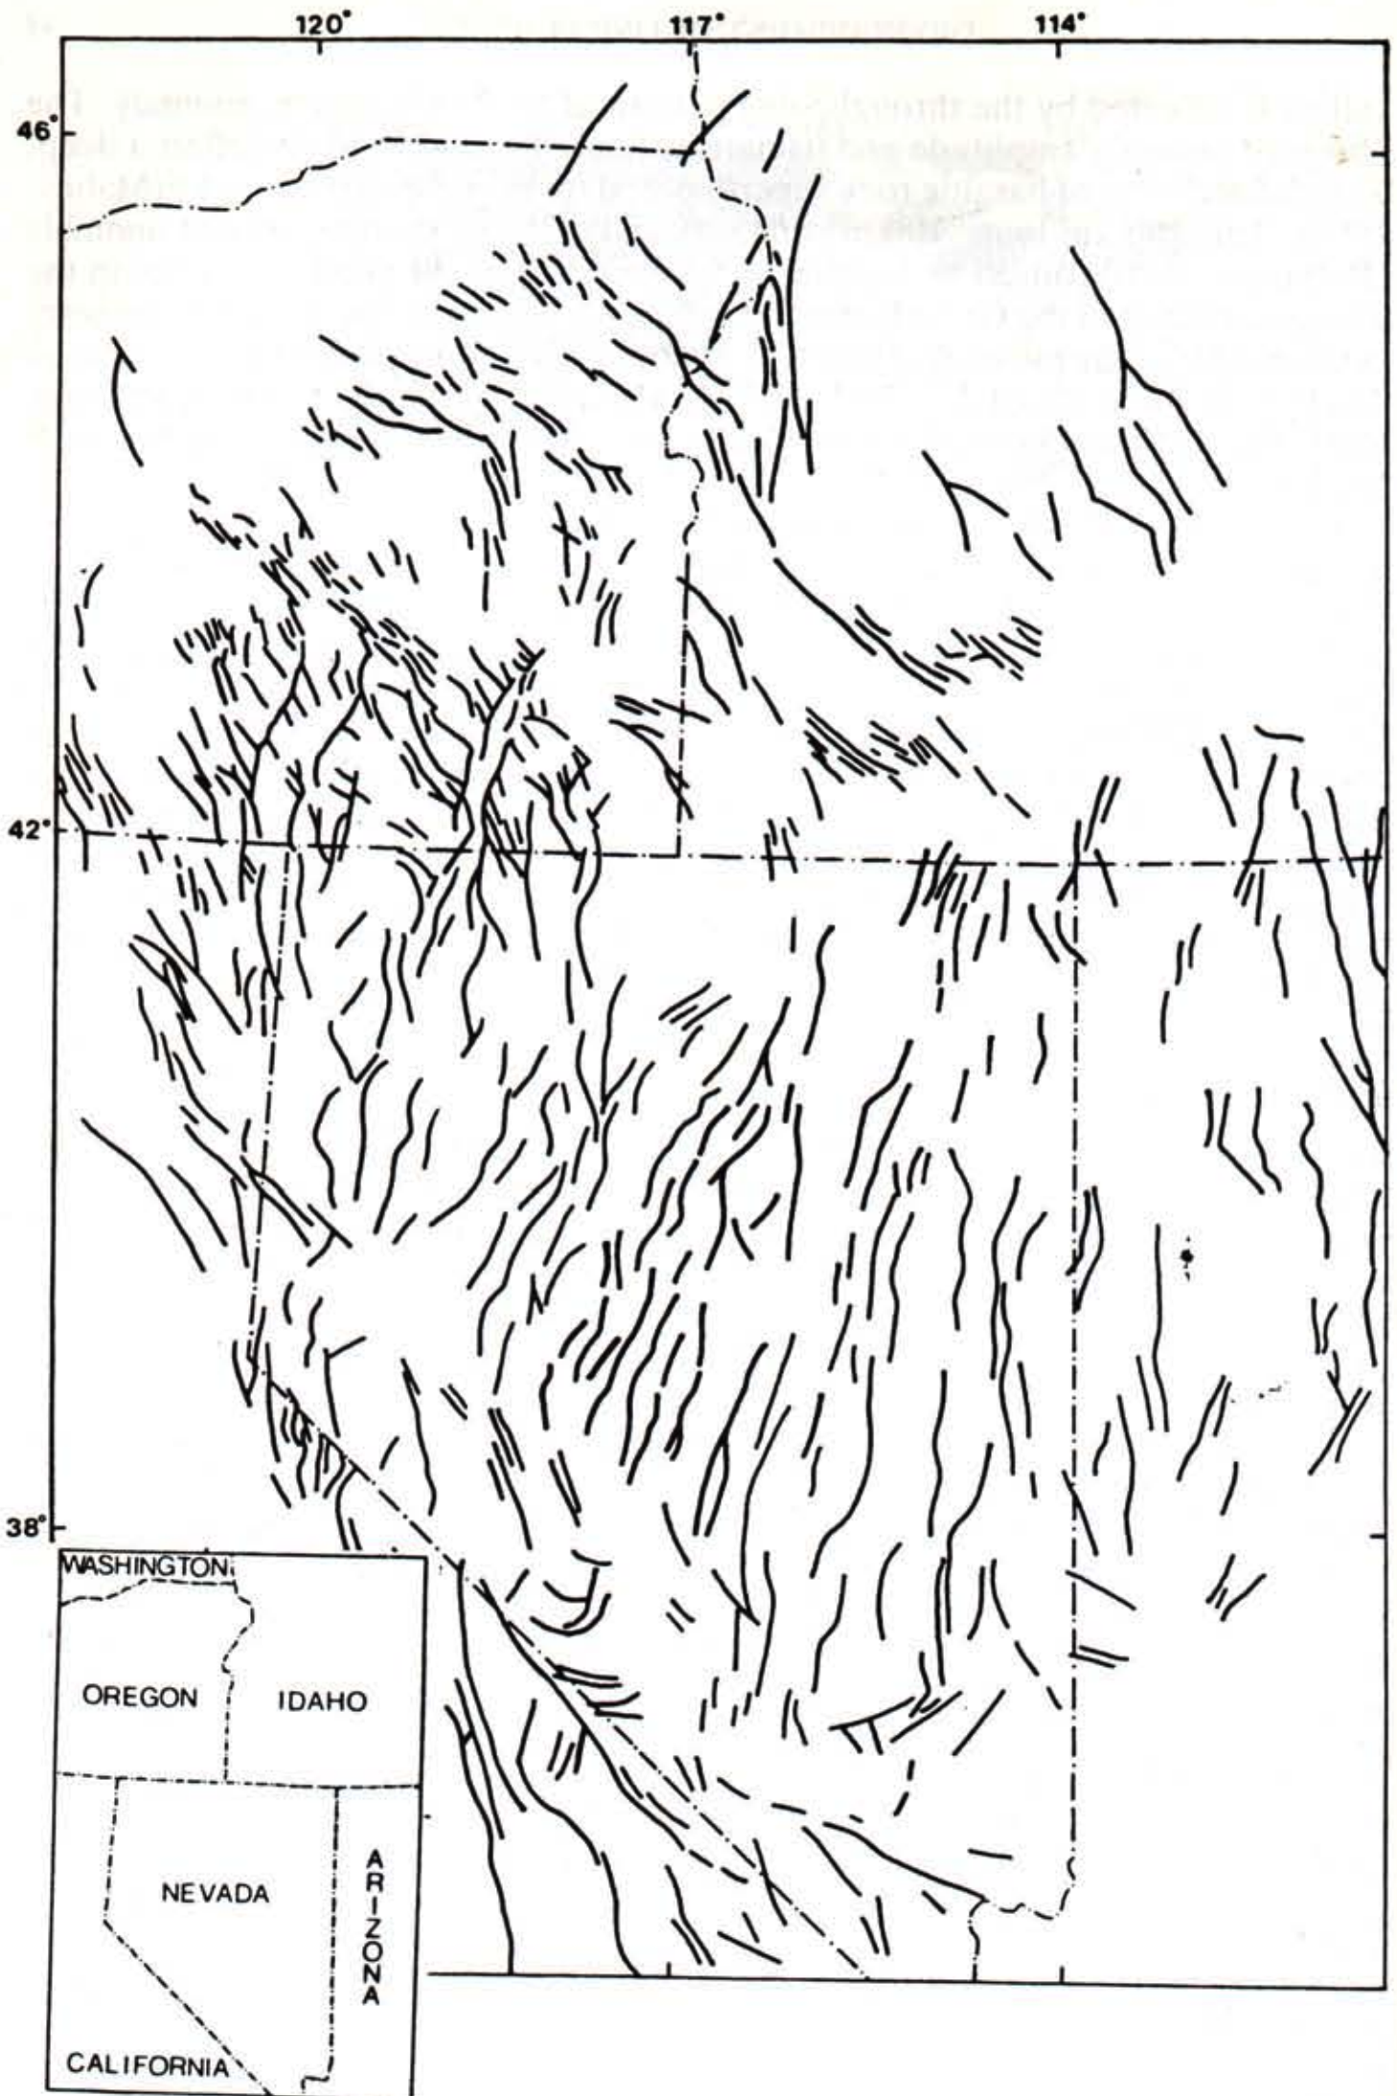
Conclusions, Part 2
What about these ACTIVE NORMAL & STRIKE SLIP FAULTS in Central Idaho, Southwestern Montana, and Northeastern Oregon?

